Slide 1
Understanding the Open Graph Protocol

Slide 2
Introduction
Facebook unveiled something called the Open Graph protocol (OGP) back in April 2010.
OGP is a mechanism that enables developers to make any web page an object in Facebook’s Social Graph by injecting some RDFa metadata into the page.

Slide 3
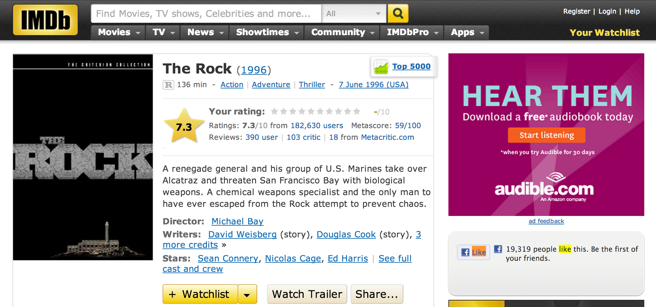
Example
Figure 2-5. An IMDb page featuring an implementation of OGP for The Rock

Slide 4
Implementation of OGP
XHTML document that uses namespaces looks something like this:
<html xmlns:og="http://ogp.me/ns#">
<head>
<title>The Rock (1996)</title>
<meta property="og:title" content="The Rock" />
<meta property="og:type" content="movie" />
<meta property="og:url" content="http://www.imdb.com/title/tt0117500/" />
<meta property="og:image" content="http://ia.media-imdb.com/images/rock.jpg" />
...
</head>
...
</html>

Slide 5
Implementation
At its core, querying the Graph API for Open Graph objects is incredibly simple:
For example, fetching the URL: http://graph.facebook.com/http://www.imdb.com/title/tt0117500 in your web browser would return this response:
{
"id": "114324145263104",
"name": "The Rock (1996)",
"picture": "http://profile.ak.fbcdn.net/hprofile-ak-snc4/hs344.snc4/...jpg",
"link": "http://www.imdb.com/title/tt0117500/",
"category": "Movie",
"description": "Directed by Michael Bay. With Sean Connery, ...",
"likes" : 3
}

Slide 6
Implementation
you explicitly request additional metadata for an object in the page by appending the query string parameter metadata=1 to the request. Here is a sample response for the query:
https://graph.facebook.com/114324145263104?metadata=1

Slide 7
Implementation
metadata": {
"connections": {
"feed": "http://graph.facebook.com/http://www.imdb.com/title/...",
"posts": "http://graph.facebook.com/http://www.imdb.com/title/...",
"tagged": "http://graph.facebook.com/http://www.imdb.com/title/...",
"statuses": "http://graph.facebook.com/http://www.imdb.com/title/...",
"links": "http://graph.facebook.com/http://www.imdb.com/title/...",
"notes": "http://graph.facebook.com/http://www.imdb.com/title/...",
"photos": "http://graph.facebook.com/http://www.imdb.com/title/...",
"albums": "http://graph.facebook.com/http://www.imdb.com/title/...",
"events": "http://graph.facebook.com/http://www.imdb.com/title/...",
"videos": "http://graph.facebook.com/http://www.imdb.com/title/...",
},
The items in metadata.connections are pointers to other nodes in the graph that you can crawl to get to other intriguing bits of data.

Slide 8
Analyzing Social Graph Connections

Slide 9
Introduction
An official Python SDK for the Graph API is a community fork of that repository previously maintained by Facebook and can be installed using:
pip install facebook-sdk.

Slide 10
Implementation Methods
Few key methods from the GraphAPI class that you need to know about in order to use the Graph API to fetch data:
1-get_object(self, id, **args)
Example usage: get_object("me", metadata=1)
2-get_objects(self, id, **args)
Example usage: get_objects(["me", "some_other_id"], metadata=1)
3-get_connections(self, id, connection_name, **args)
Example usage: get_connections("me", "friends", metadata=1)
4-request(self, path, args=None, post_args=None)
Example usage: request("search", {"q" : "social web", "type" : "page"})

Slide 11
Example 2-2. Querying the Graph API with Python
import facebook # pip install facebook-sdk
import json
# A helper function to pretty-print Python objects as JSON
def pp(o):
print json.dumps(o, indent=1)
# Create a connection to the Graph API with your access token
g = facebook.GraphAPI(ACCESS_TOKEN)

Slide 12
Example
# Execute a few sample queries
print '---------------'
print 'Me'
print '---------------'
pp(g.get_object('me'))
print
print '---------------'
print 'My Friends'
print '---------------'
pp(g.get_connections('me', 'friends'))
print
print '---------------'
print 'Social Web'
print '---------------'
pp(g.request("search", {'q' : 'social web', 'type' : 'page'}))
to query for information about you, information about your friends, and the term social web.

Slide 13
Sample Output
---------------
Me
---------------
{
"last_name": "Russell",
"relationship_status": "Married",
"locale": "en_US",
"hometown": {
"id": "104012476300889",
"name": "Princeton, West Virginia"
},
"quotes": "The only easy day was yesterday.",
"favorite_athletes": [
{
"id": "112063562167357",
"name": "Rich Froning Jr. Fan Site"
}
],

Slide 14
Sample Output
---------------
My Friends
---------------
{
"paging": {
"next": "https://graph.facebook.com/644382747/friends?...",
},
"data": [
{
"name": "Bas Russell",
"id": "6224364"
},
...
{
"name": "Jamie Lesnett",
"id": "100002388496252"
}
]
}

Slide 15
Sample Output
---------------
Social Web
---------------
{
"paging": {
"next": "https://graph.facebook.com/search?q=social+web&type=page...",
},
"data": [
{
"category": "Book",
"name": "Mining the Social Web“,
"id": "146803958708175"
},
{
"category": "Internet/software",
"name": "Social & Web Marketing",
"id": "172427156148334"
}

Slide 16
Analyzing Facebook Pages

Slide 17
Introduction
Facebook started out as more of a pure social networking site.
It quickly adapted to take advantage of the market needs.
Fast-forward a few years, and now businesses, clubs, books, and many other kinds of nonperson entities have Facebook pages with a fan base.
Facebook pages are a powerful tool for businesses to engage their customers, and Facebook has gone to some lengths to provide tools that allow Facebook page administrators to understand their fans.

Slide 18
Thank You

